Slide 1
Exploring new business opportunities in Wake County, NC
by Srinivas tatiraju
7/17/2020

Slide 2
Identifying a suitable location is key for any businessman or investor before starting a new restaurant
Once an investor makes a decision to start a new business in Wake County in NC, he needs to understand the following before zeroing in on a city and type of restaurant:
What are the various cities in Wake county in NC state?
What are the various businesses in these cities?
What is the count of each these businesses in each of these cities?
What are the most common businesses & least common food businesses in these cities?

Slide 3
Data Acquisition & Cleaning
Wake County City information
https://www.sog.unc.edu/resources/microsites/knapp-library/cities-north-carolina
Address info
geopy.geocoders
Venue info
Foursquare API
Remove the unnecessary columns
Select only the required sections from Foursquare API

Slide 4

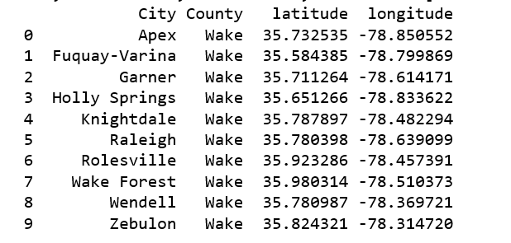



Identify Wake county cities & coordinates

Slide 5

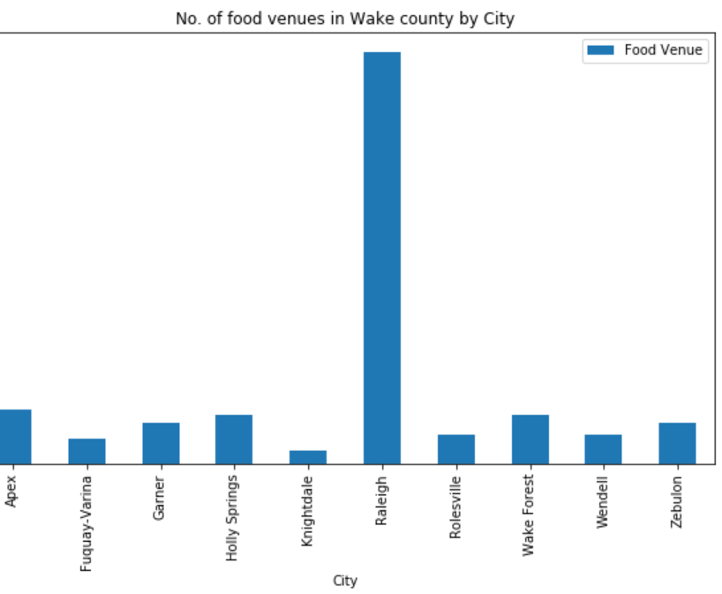
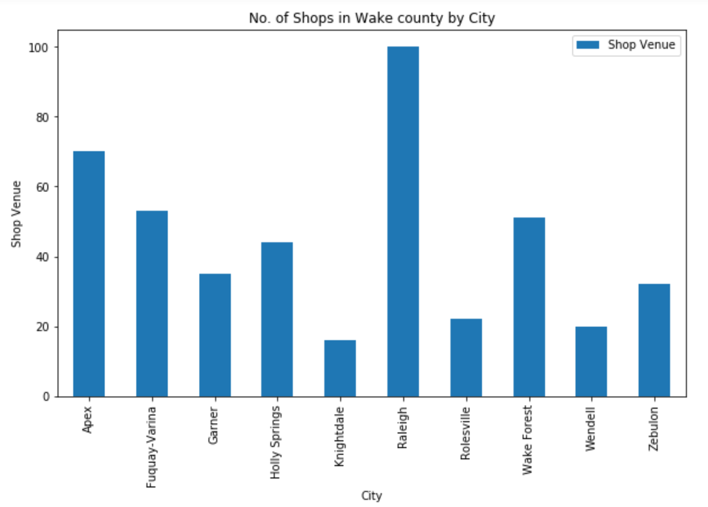
Identify no. of Food Venues & Shops

Slide 6
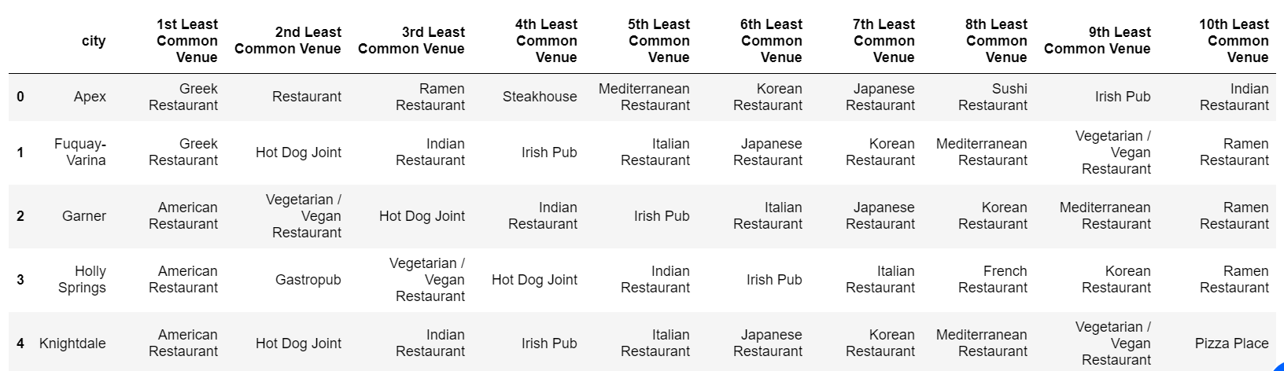
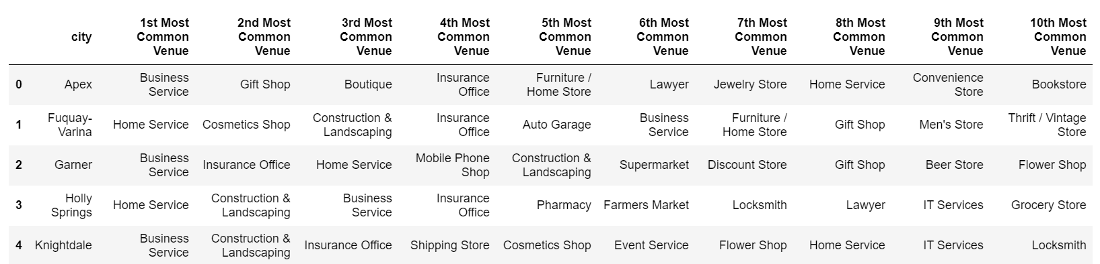
Identify least common food businesses & most common businesses

Slide 7
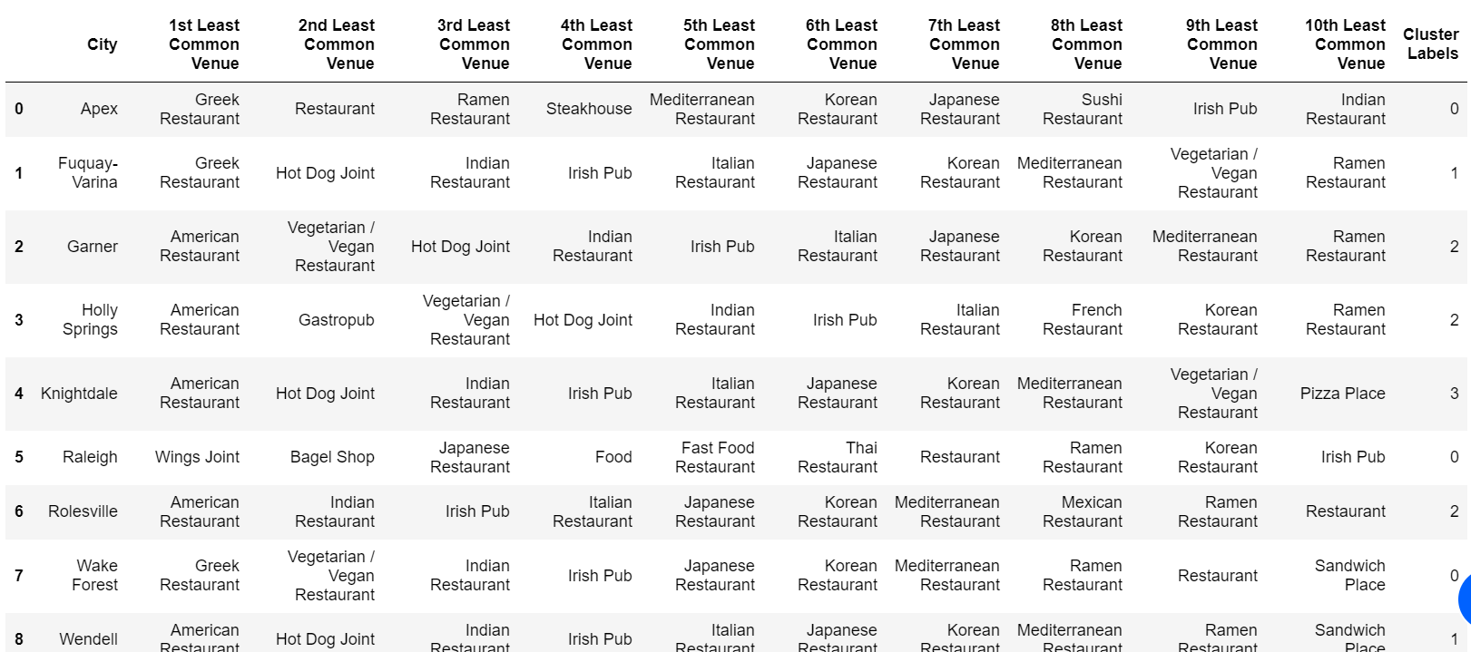
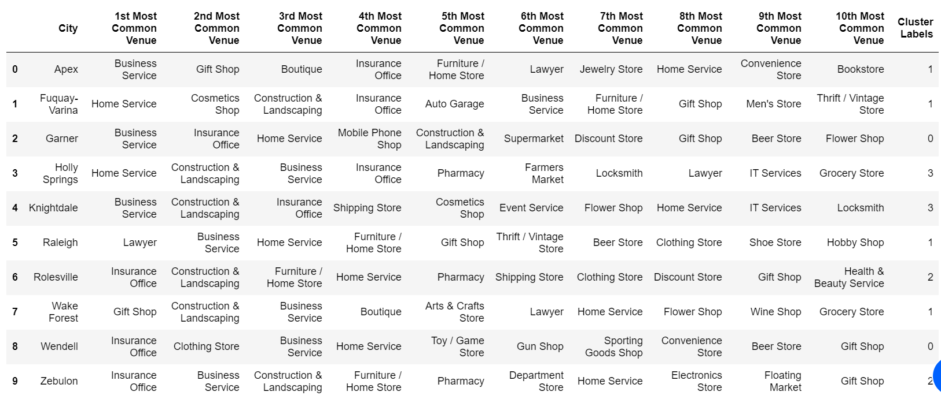
Kmeans clustering

Slide 8
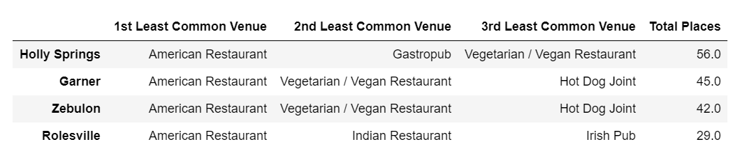
Recommendation for City/Business

